Slide 1
Immutable Infrastructures in SQA
BYUNG KANG / ROBBY LAGEN
Notes:
<Introduction>

Slide 2
Immutable Infrastructures?
Notes:
So who here has heard of immutable infrastructures?

Slide 3
Immutable Infrastructures?
Notes:
What about tools like docker?

Slide 4
Immutable Infrastructures?
Notes:
Vagrant?
So some of you guys probably know these tools but not the term for what they’re trying to achieve. And that is to make your infrastructure as immutable as possible.

Slide 5
Immutable Infrastructures?
Notes:
So what do we mean by immutable? Well, if you’re familiar with java or most other languages, strings are immutable. That is, you can’t modify the original string. and instead a new string is returned. It’s the same concept here. Instead of modifying an existing infrastructure, you return a new infrastructure.

Slide 6
Immutable Infrastructures?
Notes:
What about infrastructure? This one’s a little vague because the basic definition is the organization of the various parts of a system. All to perform some kind of an operation. You can think of roads that allow us to drive safely, or lighthouses to guide ships. But in our case, you can think of it as the environment that allows our software to run. For example, an app may depend on some dependencies and configurations for it to work. Then these dependencies and configurations must be part of the environment. That’s what we mean by infrastructure.

Slide 7
Immutable Infrastructures?
A software environment that cannot change.
Notes:
So putting these together, it’s a software environment that cannot change. If we want to modify something like updating a dependency, we’d have to create a new environment with those changes added. Again, going back to strings. It’s just like it.

Slide 8
“Immutable infrastructure is an approach to managing services and software deployments on IT resources wherein components are replaced rather than changed. An application or service is effectively redeployed each time any change occurs.”
Margaret Rouse
Notes:
Here’s a more technical definition.

Slide 9
Destroy and recreate the entire infrastructure after an IT-related update.
Notes:
Or…

Slide 10
youtube video downloader
Notes:
Let’s go over a very simple example that will help us understand why this would be useful. Say we’re wanting to create a youtube video downloader. All it does is download youtube videos to your hard drive.

Slide 11
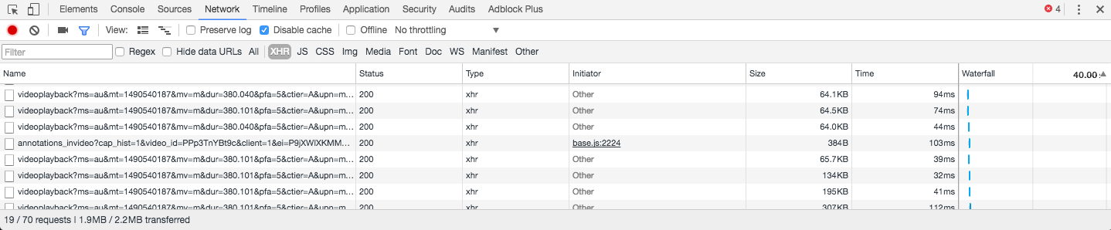
youtube video downloader
Notes:
If you remember back in the days, youtube didn’t buffer their videos. So you could literally open up your browser’s devtools and find the video it downloaded. Then save it to your computer.
However, this is how it is today. Youtube sends chunks of the video depending where you are on the video. This isn’t very useful to us. Although we could download every one of them and combine them manually, that’s very time consuming. Imagine a video that’s longer than an hour. That’s just not worth the trouble.
What we want is a tool that will fetch those chunks in parallel and combine them for us. This is actually how most youtube downloaders work.

Slide 12
Video -> Audio
Notes:
But let’s suppose that we want to add a feature. We want the ability to extract just the audio portion of the video.
So imagine a developer going to work on it and pushing his code to github. Then the QA team pulls the code to test it. However, it doesn’t work. So they tell the developer that worked on it that it doesn’t work. Then guess what the developer says

Slide 13
Video -> Audio
“It works on my machine”
Notes:
Pretty typical right?
Well, it turns out the tester’s machine didn’t have a dependency that converts video to an audio format. But the developer already had it in his machine, so he didn’t know.
And this is a very simple example, but imagine bigger applications with more dependencies. That would be very hard to keep track of.
And that’s where tools like docker and vagrant come in.

Slide 14
config
Notes:
So most of these tools have a config file where you specify the operating system, dependencies and configurations. For example, a web server may need certain ports exposed, install a runtime to run the app, create a privileged user so you don’t run as root by default. And so on.
By putting these in a file, it can actually become version controlled. If you think about it: version controlling your entire environment. It’s like a blueprint of everything that a software needs to run.

Slide 15
config
DEV
Notes:
From the developer’s point of view, whenever someone adds a dependency, that dependency would be defined in the config file. So if another developer wants to build on top of his changes, it would pull the updated config file and use docker or vagrant to recreate the environment.

Slide 16
config
DEV
QA
Notes:
The same goes for QA. They’d have the benefit of testing in the exact same environment as the developers, which not only saves their time, but the developers’ time to see why something’s not working.

Slide 17
config
DEV
QA
OPS
Notes:
And finally the operations team have a much easier time putting the product in production.

Slide 18
Why should we use it?
It works on my machine.

Slide 19
Why should we use it?
It works on my machine.

